Slide 1
MACHINE LEARNING GUILD
REGRESSION

Slide 2
INTRODUCTION
LINEAR REGRESSION?
Categorical
Continuous
Supervised
???
???
Unsupervised
???
???

Slide 3
INTRODUCTION
LINEAR REGRESSION!
Categorical
Continuous
Supervised
Classification
Regression
Unsupervised
Clustering
Dimension Reduction

Slide 4
REGRESSION
WHEN… REGRESSION?
Discuss in your groups:
What is a linear regression? Come to consensus on a definition.
Have you implemented a linear regression for a client or in practice?
What is beneficial about linear regression?
What limitations are there to linear regressions?

Slide 5
REGRESSION
WHAT… REGRESSION?
A functional relationship between input & response variables.
Think: a series of averages. Holding all else equal, an increase in the input variable averages a certain increase in the response variable.
Widely used
Low operational costs
Low tuning input
Highly interpretable
WHY… REGRESSION?

Slide 6


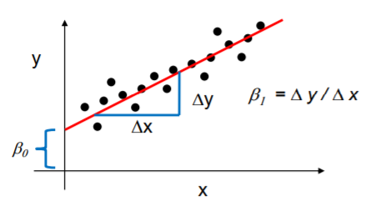
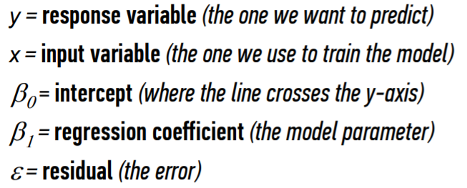
REGRESSION
WHAT… MODEL?
multiple inputs
WHAT… VARIABLES?

Slide 7
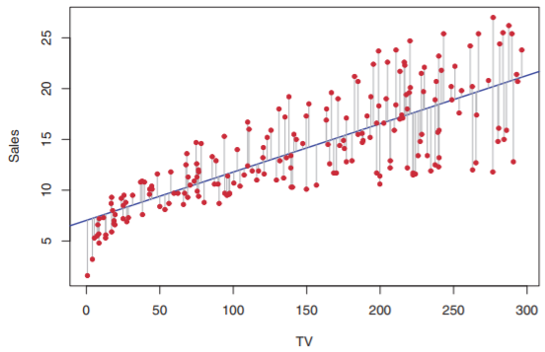
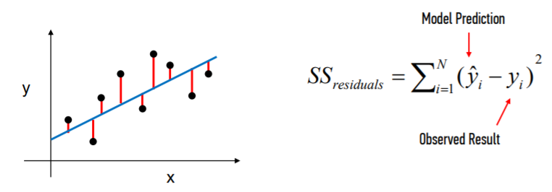

REGRESSION
HOW… COEFFICIENTS?
We estimate their value by finding a line that minimizes the sum of squared residuals.
We calculate these estimates with calculus, with a minimization equitation:

Slide 8
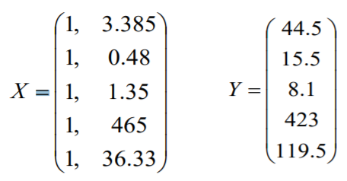
REGRESSION
HOW… COEFFICIENTS?
Example:

Slide 9
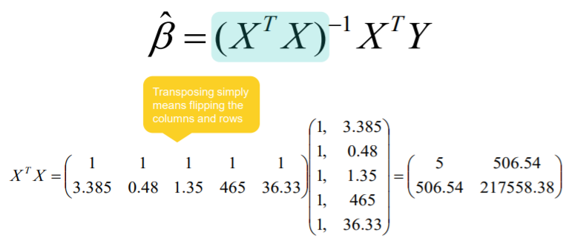
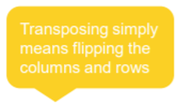
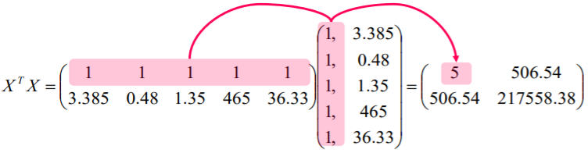
REGRESSION
HOW… COEFFICIENTS?
Step 1:

Slide 10
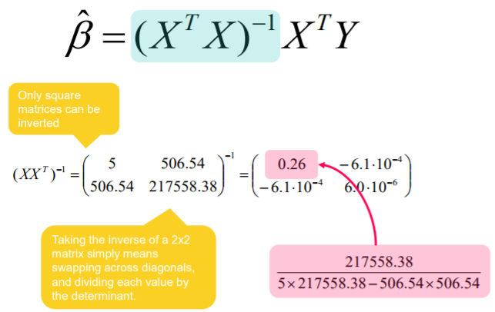
REGRESSION
HOW… COEFFICIENTS?
Step 2:

Slide 11
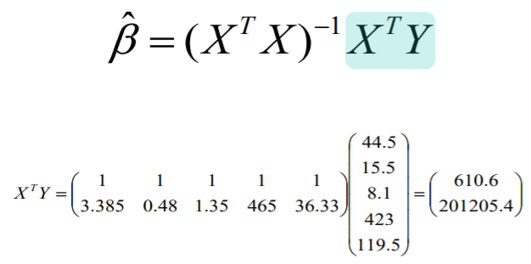
REGRESSION
HOW… COEFFICIENTS?
Step 3:

Slide 12
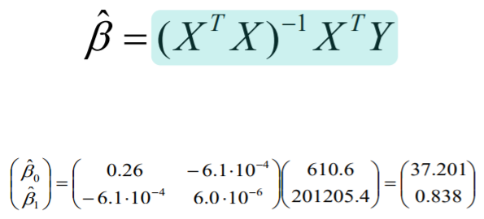
REGRESSION
HOW… COEFFICIENTS?
Step 4:

Slide 13
REGRESSION
CODING

Slide 14
REGRESSION
HOW… INTERPRET RESULTS?
For the purposes of regression, we will focus on two evaluation metrics:
WHY?
WHAT?
R-squared
Assess the relative fit of the model
The percent of variance explained by the model
Adjusted
R-squared
Assess the relative fit of the model with regards to feature important
The percent of variance explained by the model with a penalty for including useless features
RMSE
Assess the absolute fit (accuracy) of the model
The standard deviation of difference between actual and predicted values

Slide 15
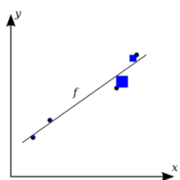
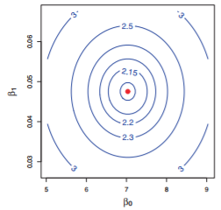
REGRESSION
HOW…MODEL ERROR?
We estimate their value by finding a line that minimizes the sum of squared residuals.
:

Slide 16
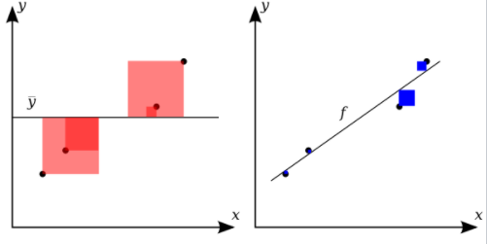



REGRESSION
HOW… INTERPRET RESULTS?
What percent of the variance in the response does the model explain?
R-squared
Note: For each sum of squares, there is an associated ‘degrees of freedom’ or df. For SS_{tot,} df = n-1, and for SS_{res,} df = n – (k + 1), where k is the number of predictors.

Slide 17

REGRESSION
HOW… INTERPRET RESULTS?
What percent of the variance in the response does the model explain?
Adjusted
R-squared
Note: The adjusted coefficient of determination is “adjusted” because each sum of squares is divided by it’s respective degrees of freedom. The adjusted value can actually become smaller with the addition of a new variable because any decrease in model error can be offset by a smaller degree of freedom (n-k-1).

Slide 18

REGRESSION
HOW… INTERPRET RESULTS?
What is the standard deviation between the predicted and observed values?
RMSE

Slide 19
REGRESSION
WHAT… ASSUMPTIONS?
Linearity
Independence of error terms
Equal variance of error terms
Normality of error terms
No outliers

Slide 20
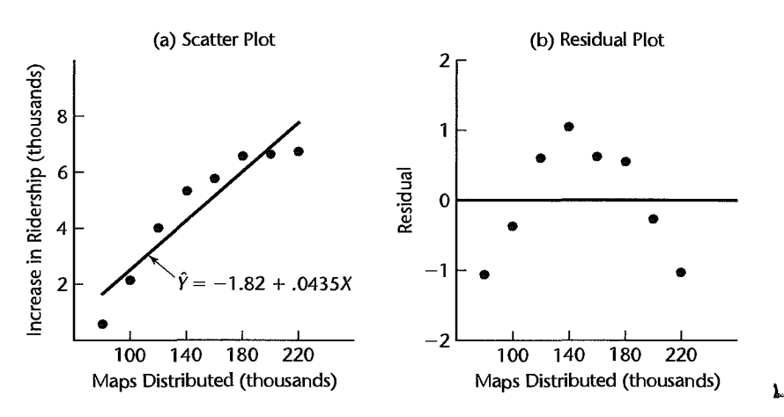
REGRESSION
HOW… CHECKING ASSUMPTIONS?
Linearity

Slide 21
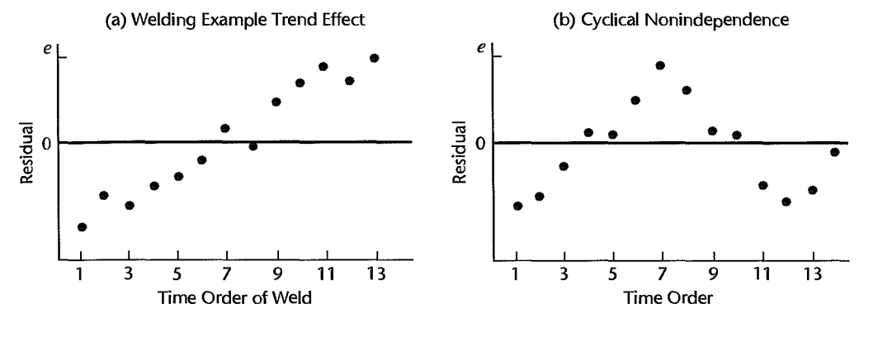
REGRESSION
HOW… CHECKING ASSUMPTIONS?
2) Independence of error terms

Slide 22
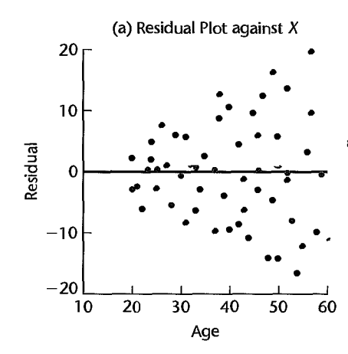
REGRESSION
HOW… CHECKING ASSUMPTIONS?
3) Equal Variance of error terms

Slide 23
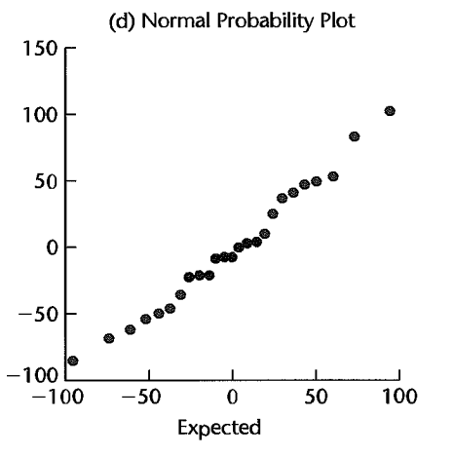
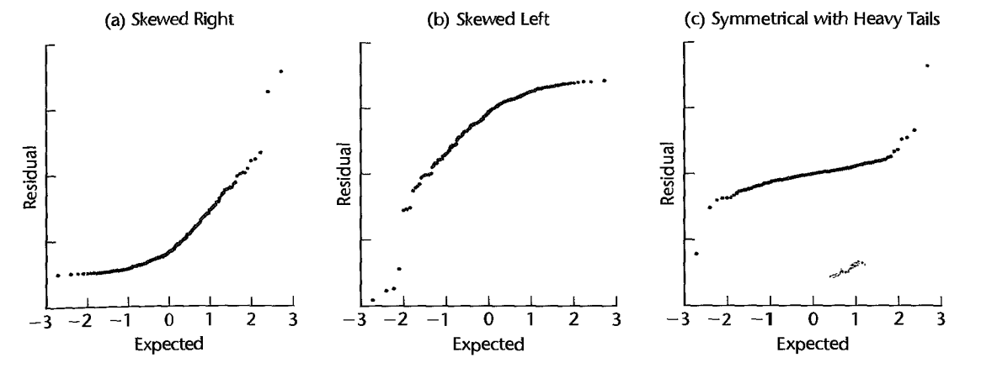
REGRESSION
HOW… CHECKING ASSUMPTIONS?
4) Normality of error terms

Slide 24
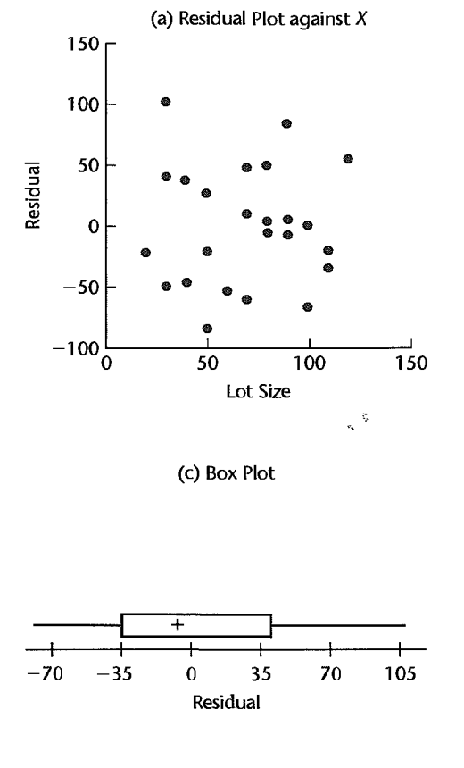
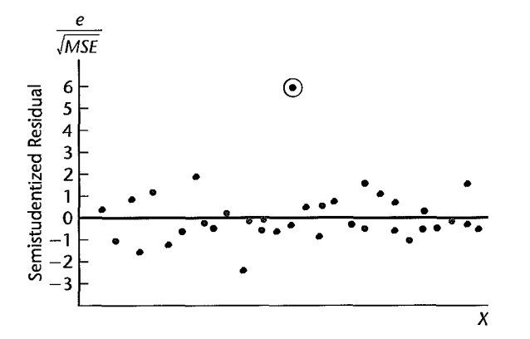
REGRESSION
HOW… CHECKING ASSUMPTIONS?
5) No outliers

Slide 25
REGRESSION
HOW…REMEDIAL MEASURES?
Diagnosing broken assumptions is often straightforward with various plots or hypothesis tests. Correcting issues with the model specification can be tricky. Here are some things to try:
Nonlinearity - Try a polynomial model or a non-linear regression (or some other machine learning techniques!)
Dependent error terms – Will likely require a different model specification (autoregression)
Heteroskedastic error terms - Try a transformation on the predictors or the target variable; weighted least squares
Nonnormality of error terms – Try a transformation on the predictors or the target variable – a transformation that alleviated issue #3 may also help with non-normality simultaneously
Outliers – Outliers generally shouldn’t be removed unless they are measurement or entry errors. Weighting can be used to reduce their effect on the model.

Slide 26
REGRESSION
CODING

Slide 27
REGRESSION
HOW… CATEGORICAL?
Discuss in your groups:
How do you deal with categorical variables with a regression?
What should you do with your Region variable? (1, 2, 3, 4)
What should you do with a star rating? (1, 2, 3, 4, 5)

Slide 28
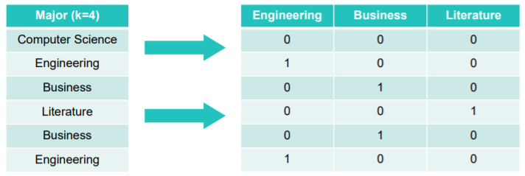
REGRESSION
HOW… CATEGORICAL?
Since all input variables for a regression must be numeric, we convert all k categorical variables to k-1 binary or “dummy” variables.
Leaving out one reference variable is important to avoid multicollinearity. This reference variable becomes the baseline for all other factor levels.
That works for nominal data, how should we treat ordinal data? [1,2,3,4,5]

Slide 29
REGRESSION
CODING

Slide 30
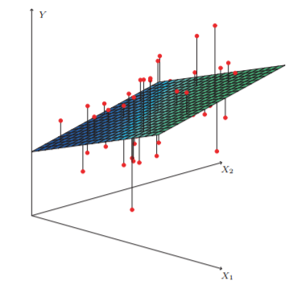
REGRESSION
HOW… VARIABLES?
Motivation: You have a lot of predictors but not enough data to estimate all of them in a meaningful way.
What methods are there for selecting your variables?
Forward Selection
Backward Selection
Best Subsets
Stepwise

Slide 31

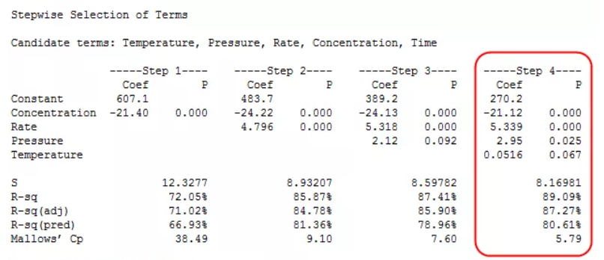
REGRESSION
t-score
HOW… VARIABLES?
What methods are there for selecting your variables?
Forward Selection
Backward Selection
Best Subsets
Stepwise
Run regression models including each predictor by itself and choose the predictor with highest t-score or lowest p-value to be added to model (as long as the t-score or p-value meets some predetermined criterion)
Repeat but run new models with the previously selected variables included. The algorithm stops when no more candidates meet the criterion.
*In backward selection, you start with all predictors in the model and systematically remove features that don’t meet t-score/p-value criterion

Slide 32
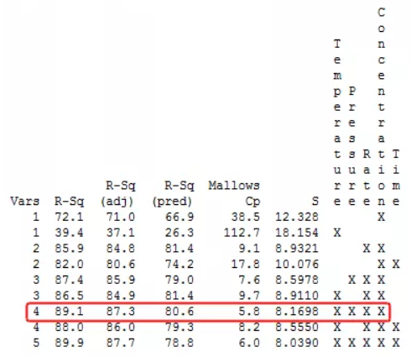

REGRESSION
HOW… VARIABLES?
What methods are there for selecting your variables?
Forward Selection
Backward Selection
Best Subsets
Stepwise
Algorithms that search for the best subsets of predictors that meet pre-specified criteria.
*The criteria used here is Mallows’ C_{p}

Slide 33
REGRESSION
HOW… VARIABLES?
For the purposes of regression, we will focus on one measure of variable significance:
WHY?
WHAT?
Assess the influence
of each input variable or the overall significance of a regression model
The probability of getting the observed outcome if the null hypothesis is true (p < 0.05 ~ significant)
p-value

Slide 34
REGRESSION
HOW… VARIABLES?
What is the probability of getting the observed outcome if null is true?
Two types of p-values for regression:
P-value for predictors
2) WHITEBOARD - P-value for overall model - F statistic, null hypothesis is that all beta parameters are 0, alternative hypothesis that at least one beta parameter does not equal 0

Slide 35
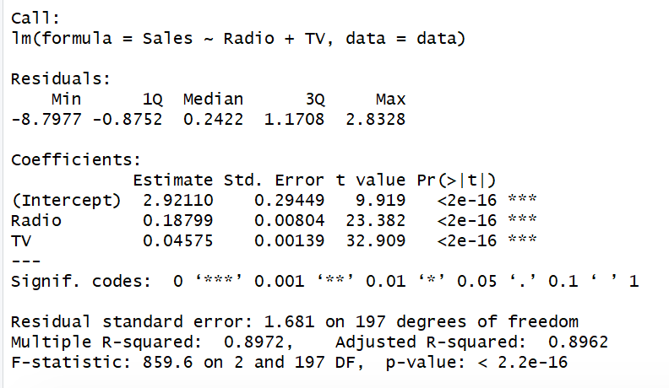
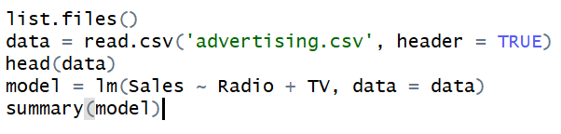
REGRESSION
HOW… VARIABLES?
Calculating p-values with sklearn LinearRegression() is a bit of work, but you can explore this on your own with the following link:
http://scikit-learn.org/stable/modules/generated/sklearn.feature_selection.f_regression.html
Here’s an example of input and output from R:

Slide 36
REGRESSION
CODING

Slide 37
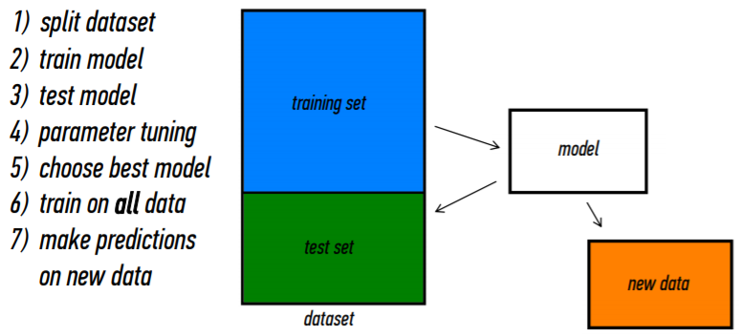
REGRESSION
HOW… MODEL TRAINING?

Slide 38
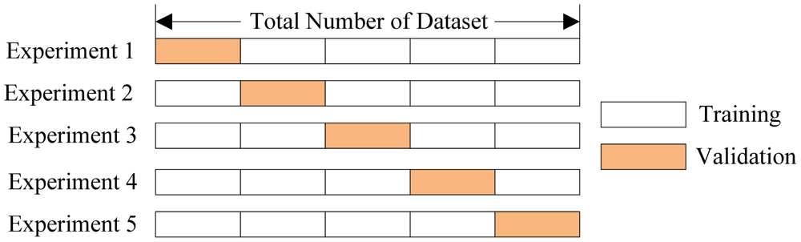
REGRESSION
HOW… CROSS VALIDATION?

Slide 39
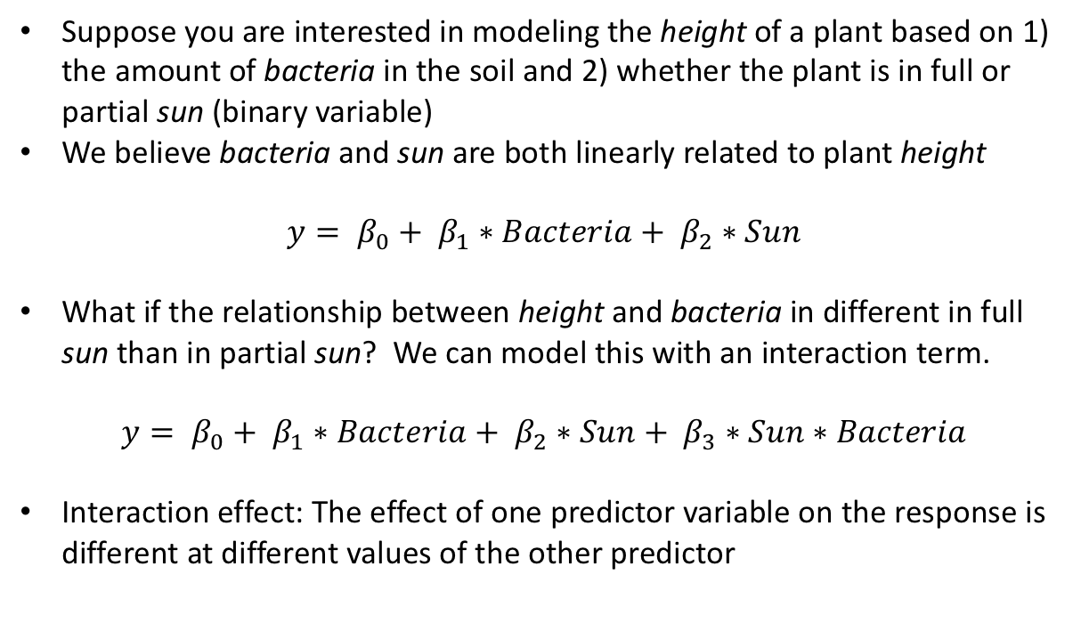
REGRESSION
HOW… INTERACTIONS?
Suppose you are interested in modeling the height of a plant based on 1) the amount of bacteria in the soil and 2) whether the plant is in full or partial sun (binary variable)
We believe bacteria and sun are both linearly related to plant height
$$y= β_{0}+ β_{1}∗Bacteria+ β_{2}∗Sun$$
What if the relationship between height and bacteria in different in full sun than in partial sun? We can model this with an interaction term.
$$y= β_{0}+ β_{1}∗Bacteria+ β_{2}∗Sun+ β_{3}∗Sun∗Bacteria$$
Interaction effect: The effect of one predictor variable on the response is different at different values of the other predictor
Notes:
Possibilities: Full sun plants with more bacteria are taller while plants with more bacteria are shorter
OR Plants with more bacteria are taller in both partial and full sun but by different magnitudes

Slide 40
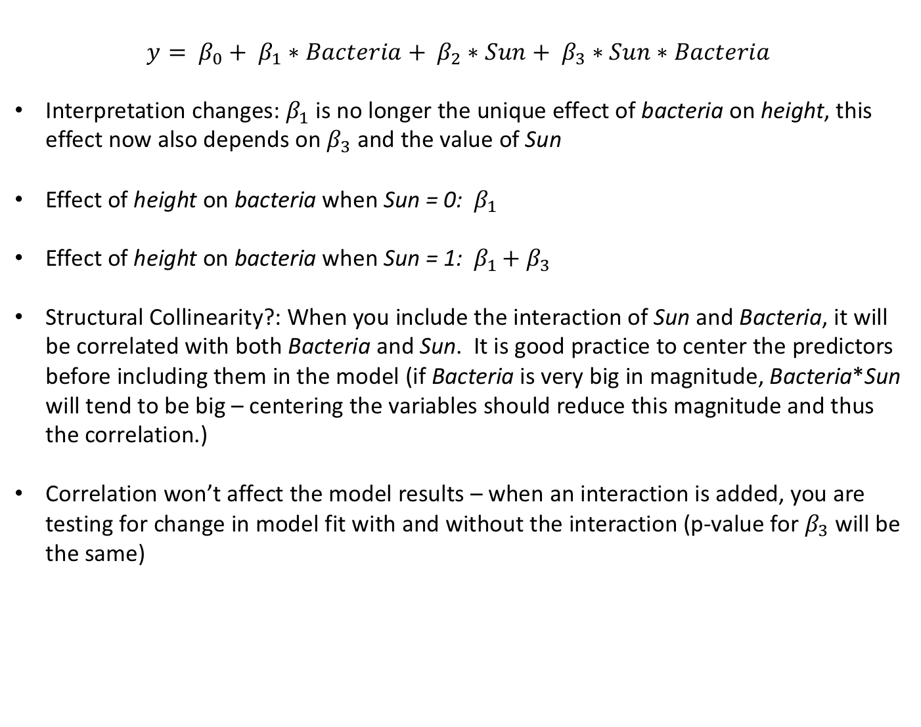
REGRESSION
HOW… INTERACTIONS?
$$y= β_{0}+ β_{1}∗Bacteria+ β_{2}∗Sun+ β_{3}∗Sun∗Bacteria$$
Interpretation changes: $β_{1}$ is no longer the unique effect of bacteria on height, this effect now also depends on $β_{3}$ and the value of Sun
Effect of height on bacteria when Sun = 0: ${ β}_{1}$
Effect of height on bacteria when Sun = 1: ${ β}_{1 }+ β_{3}$
Structural Collinearity?: When you include the interaction of Sun and Bacteria, it will be correlated with both Bacteria and Sun. It is good practice to center the predictors before including them in the model (if Bacteria is very big in magnitude, Bacteria*Sun will tend to be big – centering the variables should reduce this magnitude and thus the correlation.)
Correlation won’t affect the model results – when an interaction is added, you are testing for change in model fit with and without the interaction (p-value for $β_{3}$ will be the same)
Notes:
Possibilities: Full sun plants with more bacteria are taller while plants with more bacteria are shorter
OR Plants with more bacteria are taller in both partial and full sun but by different magnitudes

Slide 41
REGRESSION
CODING

Slide 42
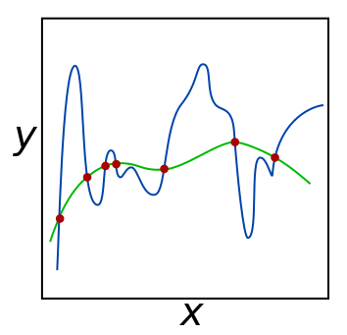
REGRESSION
WHAT… REGULARIZATION?
Process of introducing additional information in order to solve an ill-posed problem or to prevent overfitting
Overfitting: Having many features may seem like a perfect way for improving the accuracy of our trained model– because the model that will be trained will be more flexible and will take into account more parameters. On the other hand, we need to be extremely careful about overfitting the data. Every dataset has noisy samples. A model with many features (complex) might end up memorizing the noise instead of learning the trend of the data.

Slide 43
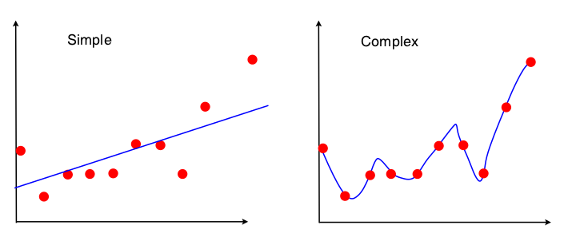
REGRESSION
WHAT… REGULARIZATION?
Bias vs. Variance: The Tradeoff
Simple models (few parameters) have higher bias, but lower variance
Result: Underfitting
Complex models (many parameters) usually have lower bias, but higher variance.
Result: Overfitting
Notes:
Here we want to increase bias to end up with more generalizable models (lower variance)

Slide 44

REGRESSION
WHAT… REGULARIZATION?
“Imposing a penalty on complexity”
Minimizing RSS
Minimizing Betas

Slide 45
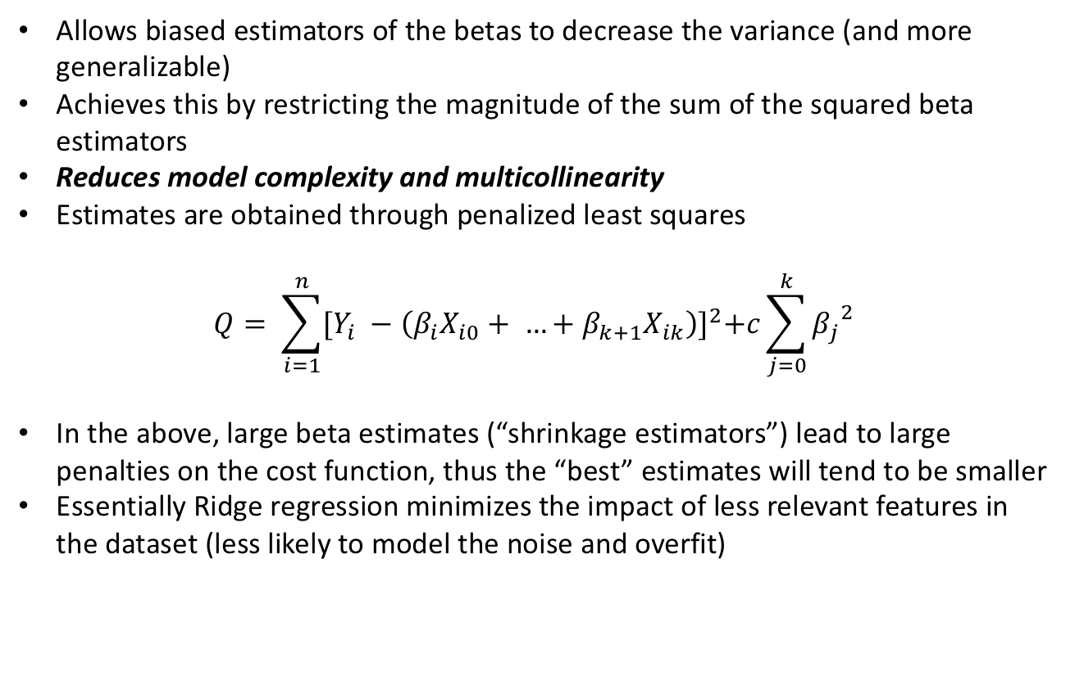
REGRESSION
HOW… RIDGE REGRESSION?
Allows biased estimators of the betas to decrease the variance (and more generalizable)
Achieves this by restricting the magnitude of the sum of the squared beta estimators
Reduces model complexity and multicollinearity
Estimates are obtained through penalized least squares
$$Q= \sum_{i=1}^{n}{{[Y_{i} −\left(β_{i}X_{i0}+ …+β_{k+1}X_{ik}\right)]}^{2}+c\sum_{j=0}^{k}{{β_{j}}^{2}}}$$
In the above, large beta estimates (“shrinkage estimators”) lead to large penalties on the cost function, thus the “best” estimates will tend to be smaller
Essentially Ridge regression minimizes the impact of less relevant features in the dataset (less likely to model the noise and overfit)
Notes:
https://codingstartups.com/practical-machine-learning-ridge-regression-vs-lasso/

Slide 46
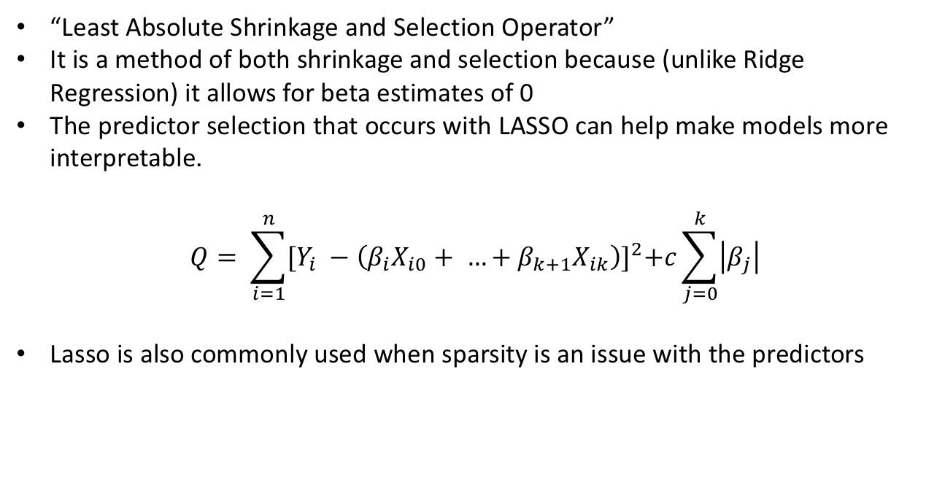
REGRESSION
HOW… LASSO?
“Least Absolute Shrinkage and Selection Operator”
It is a method of both shrinkage and selection because (unlike Ridge Regression) it allows for beta estimates of 0
The predictor selection that occurs with LASSO can help make models more interpretable.
$$Q= \sum_{i=1}^{n}{{[Y_{i} −\left(β_{i}X_{i0}+ …+β_{k+1}X_{ik}\right)]}^{2}+c\sum_{j=0}^{k}{\left|β_{j}\right|}}$$
Lasso is also commonly used when sparsity is an issue with the predictors
Note: It is common practice to center your predictors before performing Lasso or Ridge Regression because predictors with very high values will results in betas of high magnitude

Slide 47
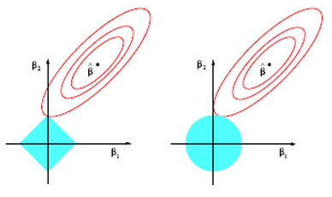
REGRESSION
HOW… REGULARIZATION?
“Imposing a penalty on complexity”
Lasso
Ridge

Slide 48
REGRESSION
Lasso vs. Stepwise Selection?
Stepwise selection is okay when you assume that your predictors are not highly correlated
Use Lasso when you have sparsity in your predictors and would like to benefit from both feature selection and regularization.
When you have groups of correlated predictors in the dataset, Lasso tends to select one variable from each group, ignoring other correlated variables. This is not optimal but may be preferable to Stepwise Regression techniques that result in all variables from a correlated group being excluded from the model.
The above issue can be resolved using an Elastic Net, which is a combination of Ridge and Lasso – see https://beta.vu.nl/nl/Images/werkstuk-fonti_tcm235-836234.pdf

Slide 49
REGRESSION
CODING

Slide 50
INTRODUCTION
LOGISTIC REGRESSION?
Categorical
Continuous
Supervised
???
???
Unsupervised
???
???

Slide 51
INTRODUCTION
LOGISTIC REGRESSION!
Categorical
Continuous
Supervised
Classification
Regression
Unsupervised
Clustering
Dimension Reduction

Slide 52
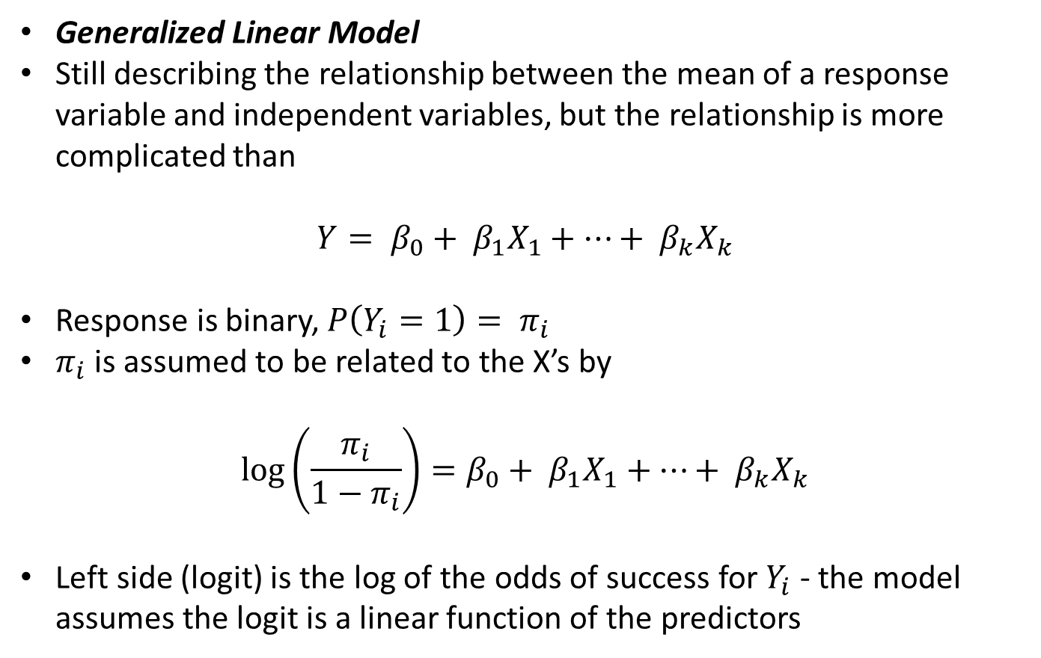
INTRODUCTION
LOGISTIC REGRESSION!
Generalized Linear Model
Still describing the relationship between the mean of a response variable and independent variables, but the relationship is more complicated than
$$Y= β_{0}+ β_{1}X_{1}+…+ β_{k}X_{k}$$
Response is binary, $P\left(Y_{i}=1\right)= π_{i}$
$π_{i}$ is assumed to be related to the X’s by
$$\log\left(\frac{π_{i}}{1−π_{i}}\right)=β_{0}+ β_{1}X_{1}+…+ β_{k}X_{k}$$
Left side (logit) is the log of the odds of success for $Y_{i}$ - the model assumes the logit is a linear function of the predictors

Slide 53
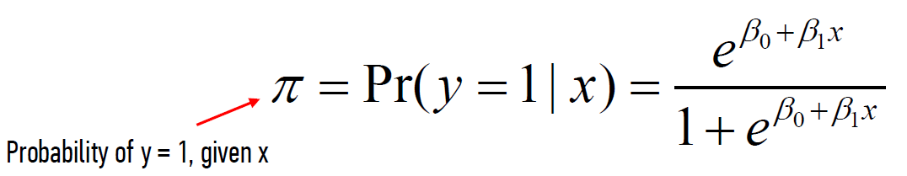
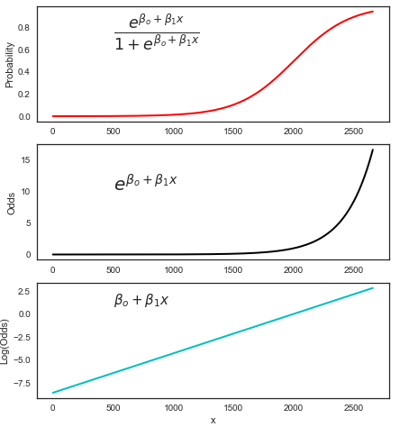
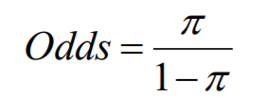


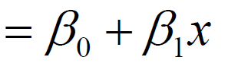
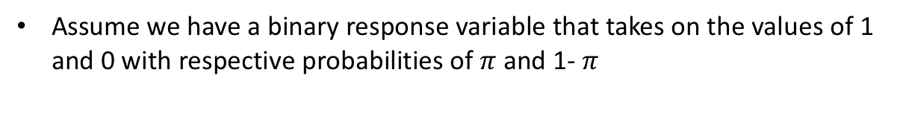
INTRODUCTION
LOGISTIC REGRESSION!
Assume we have a binary response variable that takes on the values of 1 and 0 with respective probabilities of $π$ and 1- $π$
Log( )

Slide 54
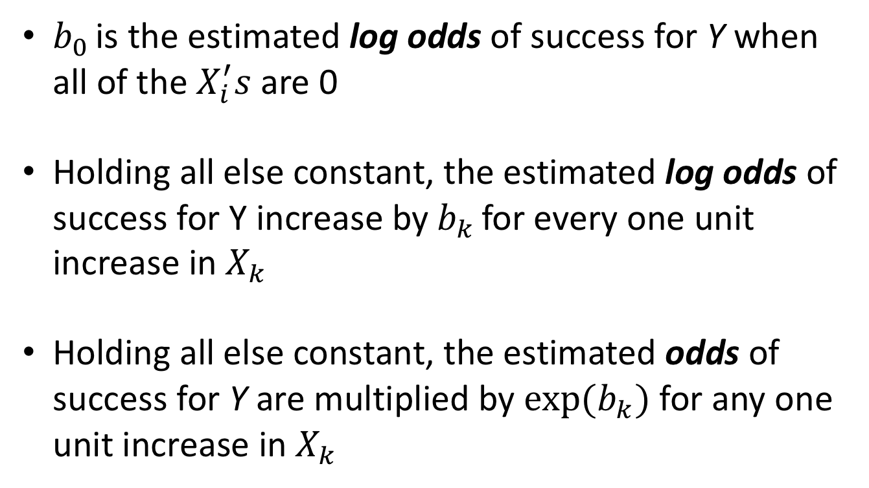
INTRODUCTION
HOW…INTERPRETING COEFFICIENTS?
$b_{0 }$is the estimated log odds of success for Y when all of the $X_{i}^{′}s$ are 0
Holding all else constant, the estimated log odds of success for Y increase by${ b}_{k }$for every one unit increase in $X_{k}$
Holding all else constant, the estimated odds of success for Y are multiplied by ${exp⁡(b}_{k})$ for any one unit increase in $X_{k}$

Slide 55
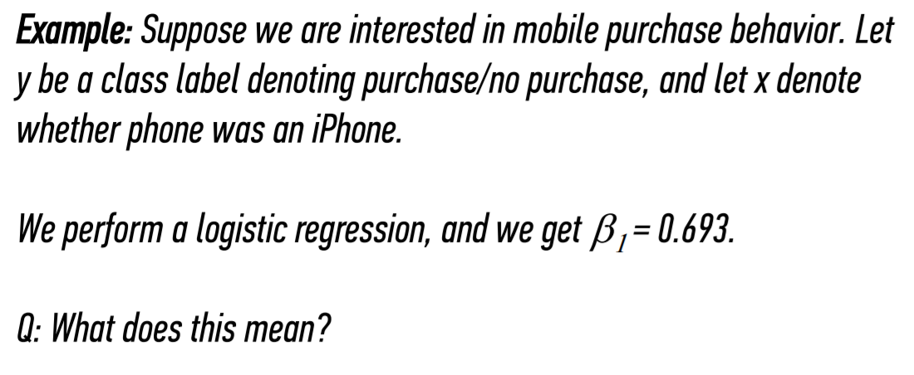
INTRODUCTION
LOGISTIC REGRESSION!

Slide 56
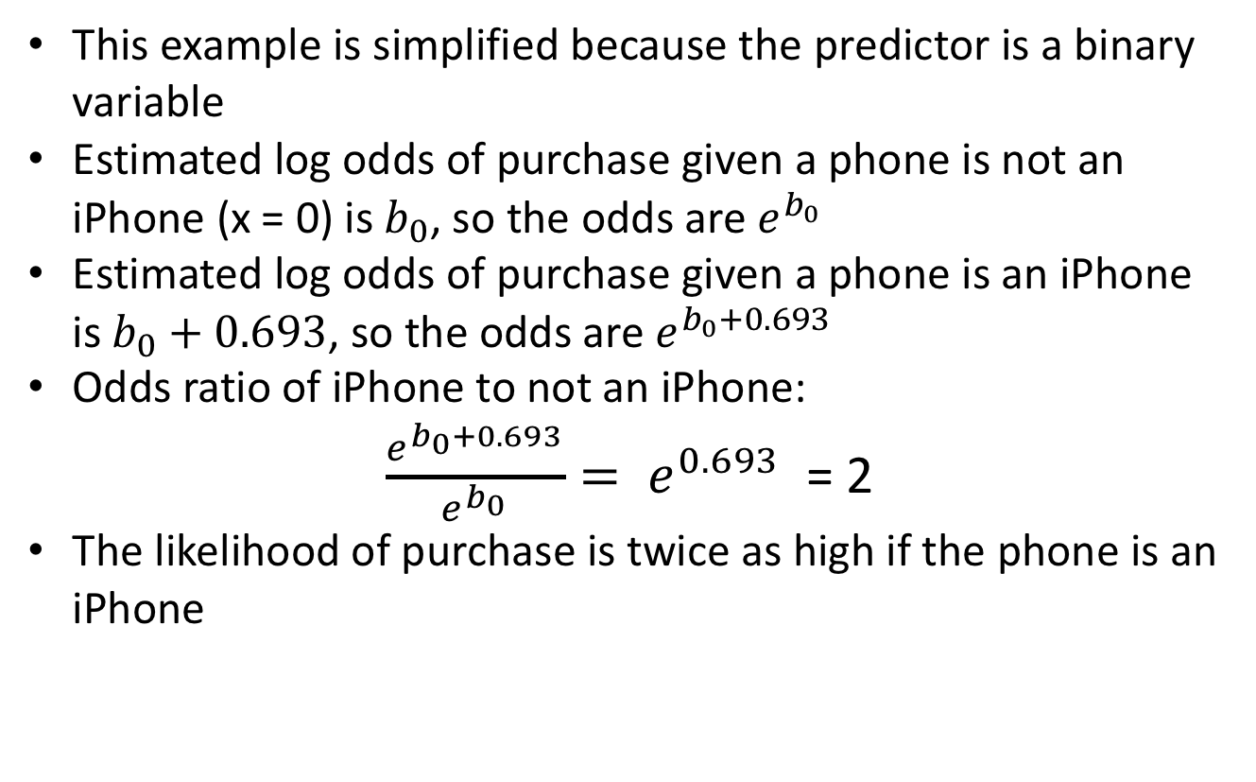
INTRODUCTION
HOW…INTERPRETING COEFFICIENTS?
This example is simplified because the predictor is a binary variable
Estimated log odds of purchase given a phone is not an iPhone (x = 0) is $b_{0}$, so the odds are $e^{b_{0}}$
Estimated log odds of purchase given a phone is an iPhone is $b_{0}+0.693$, so the odds are $e^{b_{0}+0.693}$
Odds ratio of iPhone to not an iPhone:
$\frac{e^{b_{0}+0.693}}{e^{b_{0}}}= e^{0.693}$ = 2
The likelihood of purchase is twice as high if the phone is an iPhone

Slide 57
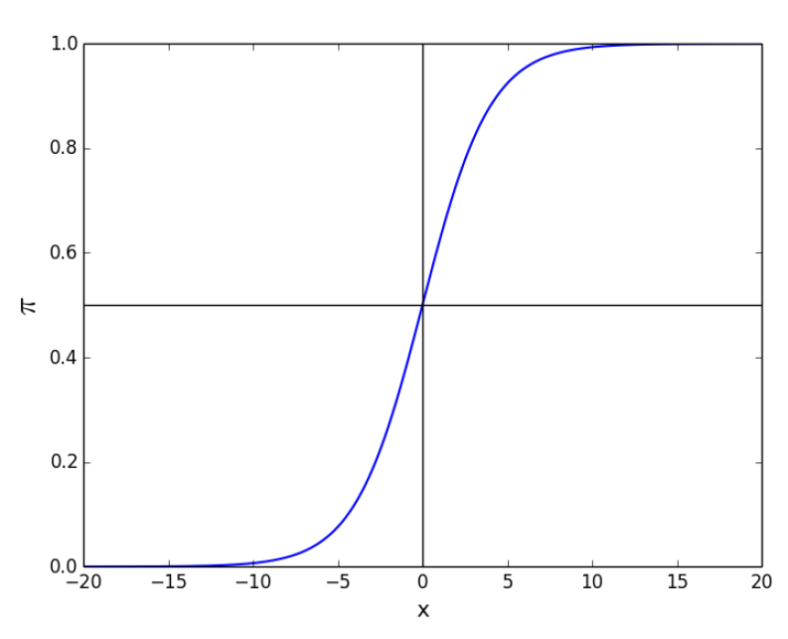
INTRODUCTION
LOGISTIC REGRESSION!
Why is it sensible that it is this shape?

Slide 58
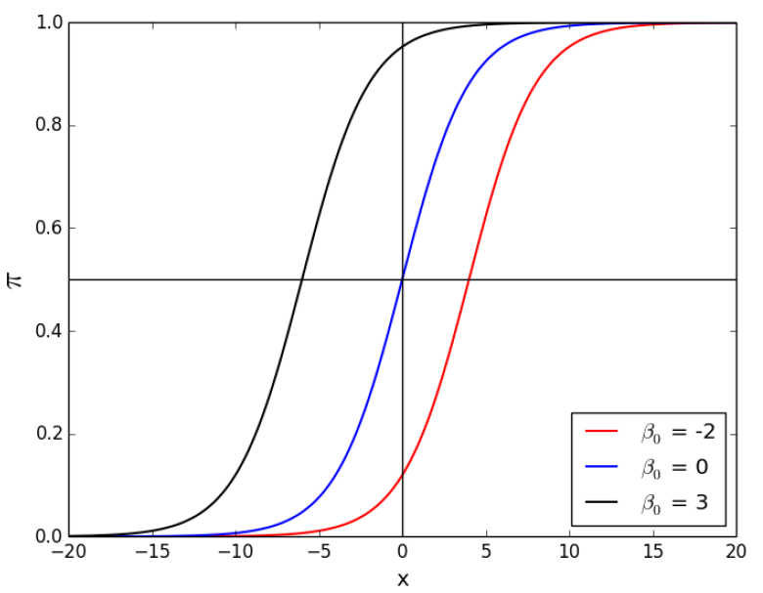
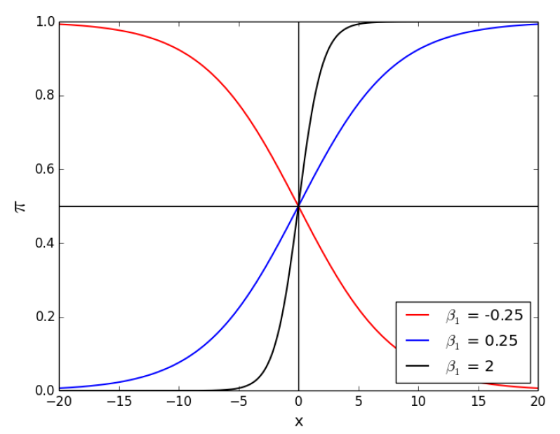
INTRODUCTION
LOGISTIC REGRESSION!
Changing the beta values…

Slide 59
INTRODUCTION
LOGISTIC REGRESSION!
Changing the beta values…

Slide 60
REGRESSION
CODING

